Slide 1

FITWELL ANALYTICS
Valarmathi Ganessin• 27.04.2024

Slide 2
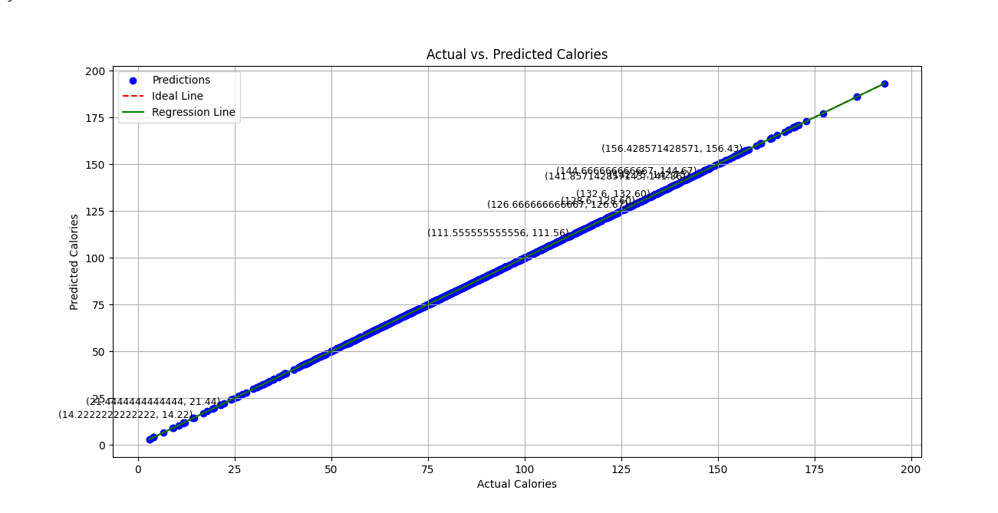
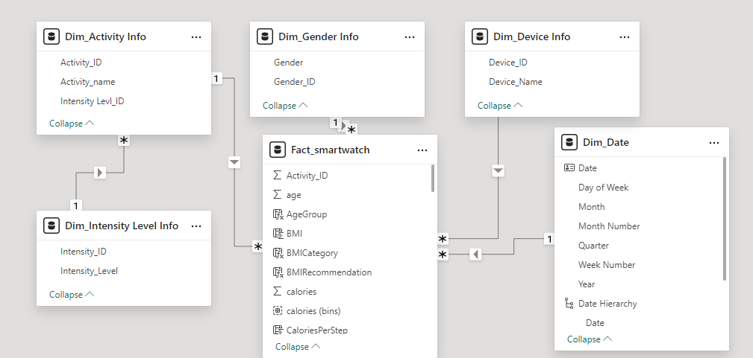
Tech Details
Linear Regression Output
Dependencies used
pandas==1.4.2
numpy==1.22.3
matplotlib==3.5.1
scikit-learn==1.0.2
seaborn==0.11.2
missingno==0.4.2
Environment
Python 3.8
Power BI Desktop
MS Excel
PyCharm
Data Model

Slide 3
FITWELL ANALYTICS FOR BUSINESS FINDINGS
Strong Predictive Power: The linear regression model demonstrated high predictive power with an R-squared value of 1.0, indicating that the model perfectly explains the variance in heart rate based on the selected fitness metrics.
Significant Features: Features such as steps, calories burned, and intensity Karvonen showed strong correlations with heart rate, suggesting these metrics are critical predictors of cardiovascular activity.
Model Accuracy: The model's accuracy was further highlighted by low Mean Absolute Error (MAE) and Mean Squared Error (MSE) values, indicating minimal prediction errors and high reliability in the model's predictions.
Heart Rate Variability: The analysis revealed that heart rate variability is well-captured by the combination of multiple fitness metrics, allowing for precise and comprehensive heart rate predictions.
Feature Interactions: Interactions between features, such as the correlation between steps and calories, enhanced the model's ability to predict heart rate accurately, demonstrating the importance of considering multiple related metrics in predictive modeling.
Thank YOU

